Slide 1
Brexit in the Europe. Where to go from London?
Relocation of financial professionals as a Data Science task.

Slide 2
London is a leading world financial center From history: London took over as a major financial center shortly after 1795 when the Dutch Republic collapsed before the Napoleonic armies.
London is one of the pre-eminent financial centers of the world
"Brexit" is the withdrawal of the United Kingdom (UK) from the European Union (EU)
The consequences of Brexit
as of 2016 London tops the world rankings on the Global Financial Centres Index (GFCI),[280] and it ranked second in A.T. Kearney's 2018 Global Cities Index.
The broad consensus among economists is that Brexit will likely reduce the UK's real per capita income in the medium term and long term, and that the Brexit referendum itself had damaged the economy.
The consequences of Brexit are tremendous for London city and financial sector overall. New York has overtaken London as the world’s most attractive financial center

Slide 3
Economic and financial impact of Brexit: London’s future as an international financial center depends on whether the UK will obtain passporting rights for British banks from the European Union
Название графика
London will loose its role as a leading financial center.
Many financial professionals will relocate.
The role of other financial centers will increase.
New York has overtaken London as the world’s most attractive financial center, The consequences of Brexit are tremendous for London city and financial sector overall.
Britain’s decision to leave the EU prompts banks to shift jobs out of the city to keep access to Europe’s single market.
Should the passporting agreement expire in the event of a Brexit, the British financial service industry might lose up to 35,000 of its 1 million jobs

Slide 4
Cities-competitors – enticing invitations for London financiers
Many world countries and their capitals dream to increase their role as financial centers of the world
New York
Frankfurt
Berlin
Benefits of catching London’s finance professionals
catch the payrolls taxes and direct economic impact of financial institutions relocation from London
guaranteed property prices surge
cultural level and world authority increase
Paris
Dublin
Amsterdam
Luxembourg
Singapore
Hong Kong

Slide 5
If relocate, how to select a new city to work and live? there are many aspects to consider on decision to relocate, but the first question is – if new place is geographically similar to London?
How to choose the right city to go from London because of Brexit?
Compare every alternative to London City
The city to go tends to be similar to London from workplace view.
Make geographical analysis how London City and alternatives are similar
Financiers work, rest and have families.
Compare every alternative to London recreational, or “sleeping” neighborhoods.
The city to go from London tends to be similar to London from recreational and amusement point of view
Make geographical analysis how London “sleeping” neighborhoods and those for alternatives are similar

Slide 6
Data science approach to relocation alternative selection: analyzing cities as a collection of venues
we can compare cities as a collection of venues. We choose the grid-centric approach as the most appropriate to characterize a city by the ensemble of amenities it offers.
define bag of venues
bag of venues is a representation of a spatial region r. If there are n venues located within r, and each is chosen from a global set of m venue categories, then we define the m-dimensional bag of venues vector
to get the bag of venues we normalize vector of counted venues for every unique venue category inside the selected spatial grid
obtain venues data
Obtain coordinates of venues in the city centers
Obtain the list of recreational (“sleeping”) neighborhoods for every city and their coordinates
Use Foursquare to get all the venues inside selected area
analyze bag of venues for every city
Cluster the bag-of-venues vectors for city center
Cluster the bag-of-venues vectors for sleeping areas of the cities
Find the city, similar to London
Check the consistency of the approach

Slide 7
Algorithm runs sequentially. we have two sub-tasks – analyze data for city centers and for “sleeping” areas
we choose the grid-centric approach as the most consistent
Choose the step and make a grid for analyzing areas in city centers
we make a grid for London City and central parts of alternatives. We choose 10 steps, each for 600 meters, to cover the central part of each city. I.e. "central" in our work means 6 km x 6km area around cities centers
Текст
obtain venues for the every grid node and accumulate the nodes for every city, make the overall list of venues categories,
add the list of venue's categories from other and sort them alphabetically
Текст
normalize our bags
compare the bags of venues by means of the hierarchical clustering
Choose the step and make a grid for anal
choose 4 (four) recreational zones neighborhoods for every city and make grid for them with the step of 400 meters and 2 steps in longitude and latitude directions (9 points overall) for every neighborhood
Текст
obtain venues for all grid nodes and accumulate the bags of venues for all four neighborhoods in every city
Текст
normalize our bags
compare the bags of venues by means of the hierarchical clustering
Текст
Текст
Текст
Текст

Slide 8
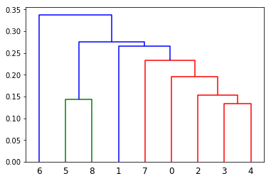
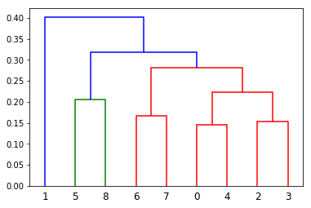
Results – final clustering for city centers and for sleeping areas New York City (0), Paris France (1), Frankfurt, Germany (2), Berlin, Germany (3), Amsterdam, Netherlands (4), Dublin, Ireland (5), Singapore, Singapore (6) and Hong Kong, China (7)
Compare to London (8)
Clustering for city centers
Clustering for “sleeping” areas

Slide 9
Conclusion
For workplace areas
London and Dublin are most similar. But we also see Paris and Singapore as next similar to London alternatives
For recreational (“sleeping”) areas
London and Dublin are most similar
the selected method is consistent and logically clear, because we get 3 pairs of the similar and "close proximity" cities:
first pair – saxonic cities of London (8) and Dublin(5);
second pair – German cities Frankfurt (2) and Berlin (3)
third pair – South-east Asia cities of Singapore(6) Hong Kong(7)
Relocation to Dublin is most convenient as London and Dublin are similar for workplace and recreational neighborhoods

